Slide 1
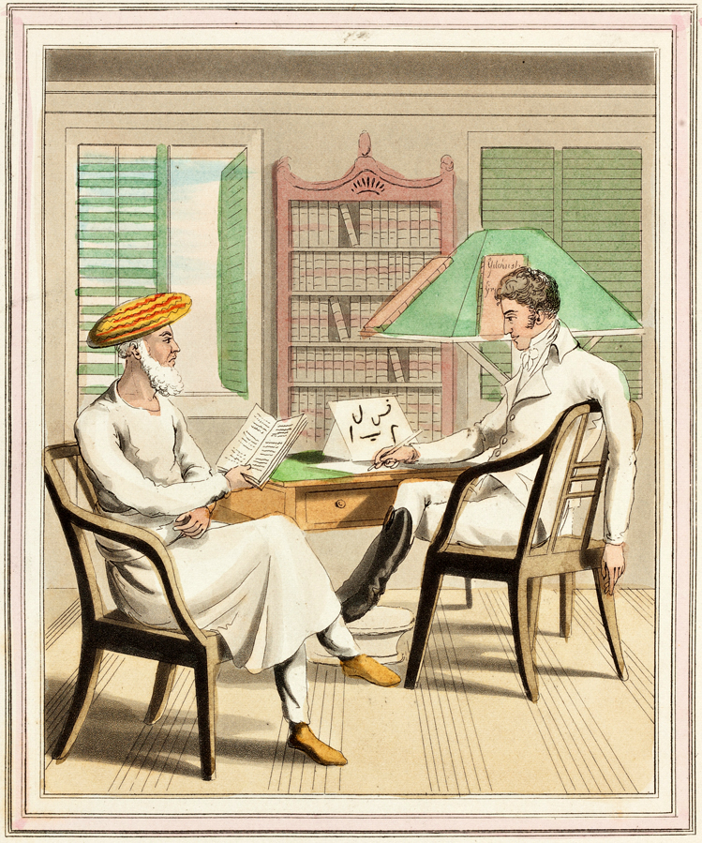
Global IR and Regional Worlds
Beyond Sahibs and Munshis:
A New Agenda for International Studies
Presidential Address to the 55th Annual Convention of the International Studies Association, Toronto,
27 March 2014
Amitav Acharya
American University

Slide 2

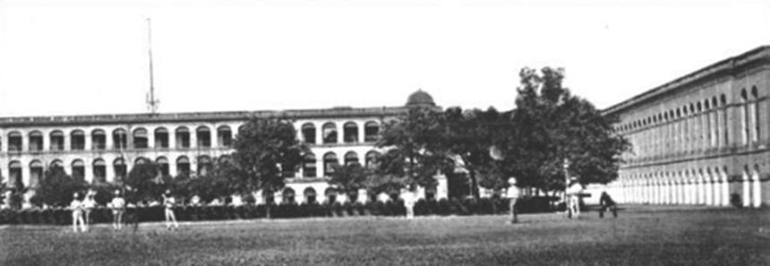


Slide 3
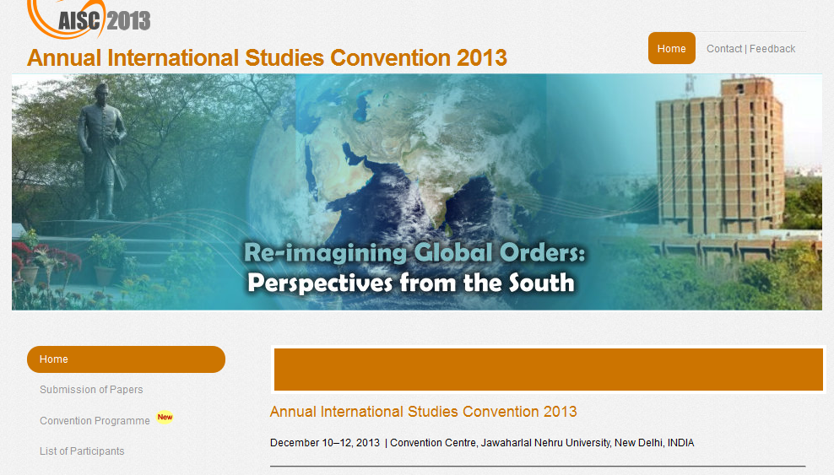

Slide 4
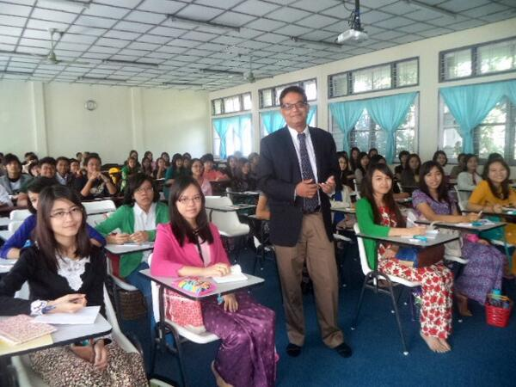
Reintroducing IR at Yangon University

Slide 5
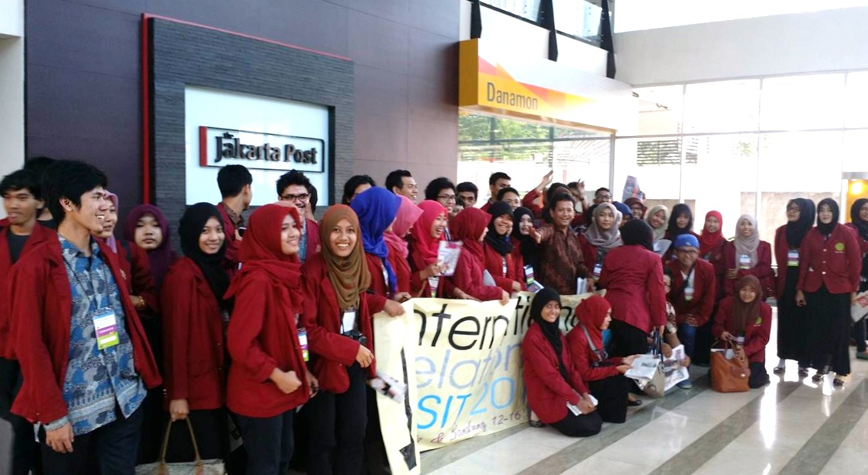
IR Students from Muhammadiyah University on Site Visit to Jakarta

Slide 6
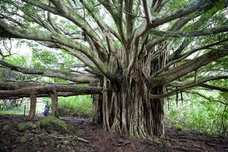
Global IR: Six Dimensions
It is founded upon a pluralistic universalism: not ‘applying to all’, but recognizing and respecting the diversity in us
It is grounded in world history, not just Greco-Roman, European or US history
It subsumes, rather than supplants existing IR theories and methods
It integrates study of regions, regionalisms and area studies
It eschews exceptionalism
It recognizes multiple forms of agency beyond material power: including resistance, normative action, and local constructions of global order

Slide 7
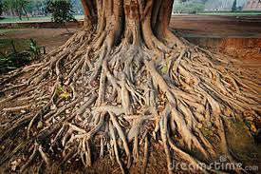
What is a Global IR Research Agenda
New patterns, theories and methods from world histories
Changes in the distribution of power and ideas after 500 years of Western dominance
Regional worlds in their full diversity and connectivity
Subjects and methods that require substantive integration of disciplinary and area studies knowledge
Circulation of ideas and norms circulate between global and local levels
Mutual learning among, rather than clash of, civilizations

Slide 8
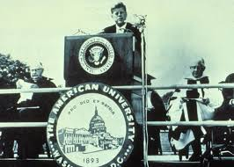
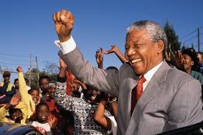
Global IR: Not Only ‘Safe’ for Diversity but Enriched By It
“If we cannot end now our differences, at least we can help make the world safe for diversity.”
John F. Kennedy
American University
Commencement Speech, 1963
“To promote institutions and forces that, through democratic means, seek to make the world safe for diversity.”
Nelson Mandela
Foreign Affair article 1993

Slide 9
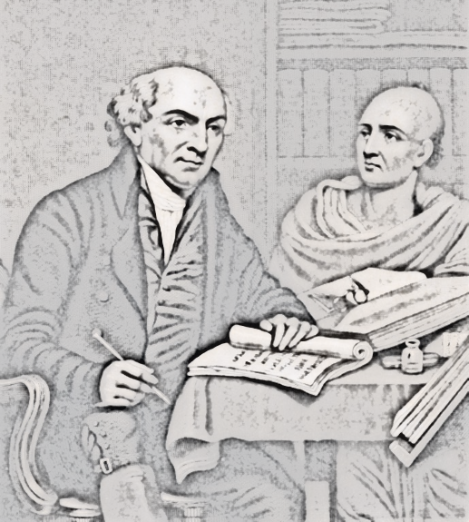
Beyond Sahibs and Munshis (and Pundits too)
Amitav Acharya
UNESCO Chair in Transnational Challenges and Governance
School of International Service
American University

